Slide 1
ENERGY transfers and transformations
YEAR 9 SCIENCE
2025

Slide 2
LEARNING INTENTIONS
Classify energy types.
Identify and describe energy transformations.
Describe the 1st Law of Thermodynamics (Law of Conservation of Energy).
Understand how energy can be transferred and/or transformed using simple scenarios.

Slide 3
WHAT IS ENERGY?

Slide 4
DEFINITION OF ENERGY
( in 3 sentences )
Work involves applying a
movement across a
object that causes
to do work.
in units called
Energy is defined as
joules (J).
force on an
the capacity
distance. Energy is measured
Energy is defined as the capacity to do work. Work involves applying a force on an object that causes movement across a distance. Energy is measured in units called joules (J).

Slide 5
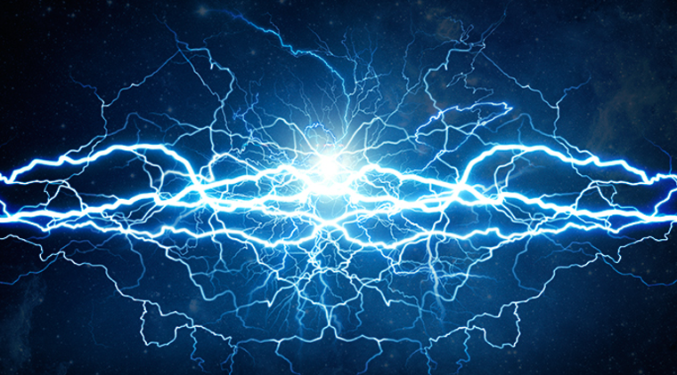
ENERGY
Name 10 things or actions which require energy…
Running
Eating
Lights
Studying
Cars
Buses
iPhones
Etc!

Slide 6
FORMS OF ENERGY
There are five energy forms missing…
Can you remember any of these? Tell your group.
(2 minutes)
NUCLEAR
HEAT/thermal
CHEMICAL
SOUND/acoustic
GRAVITATIONAL POTENTIAL (or stored gravitational)
Notes:
light, kinetic, elastic potential, electrical, magnetic, mechanical (KE + GPE)

Slide 7
FORMS OF ENERGY
For the next slide images, write definitions for the forms of energy in your WBs

Slide 8
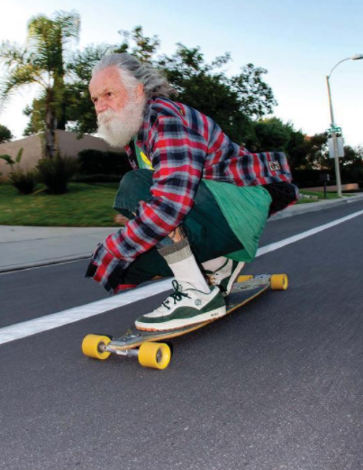
KINETIC ENERGY
The energy of movement.
E_{k} = ½ x mass x velocity²
E_{k} = ½ mv²

Slide 9
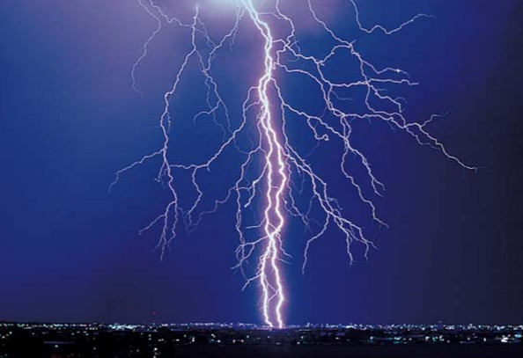
ELECTRICAL ENERGY
The energy of electrons which are flowing.

Slide 10

ELASTIC POTENTIAL ENERGY
The energy stored in a string and bow which is ready to move
(also known as stored elastic energy)

Slide 11

LIGHT ENERGY
The energy given out by LUMINOUS OBJECTS.
e.g. light bulbs, the sun, fire

Slide 12

What is energy?
Energy is the measure of the ability of an object or a system to perform work. There are many types of energy:
kinetic energy – energy of an object due to its speed
gravitational potential energy – energy of an object due to position in a gravitational field
elastic energy – energy stored when an object is stretched or compressed
chemical energy – energy stored in chemical bonds
nuclear energy – energy stored in nuclei.
Notes:
‹#›
Boardworks AS Physics
Title of presentation

Slide 13
2 MAIN GROUPS
– KINETIC & POTENTIAL ENERGY
Kinetic Energy – involves particles moving | Potential Energy – any energy that can be stored
Kinetic Energy – involves particles moving | Potential Energy – any energy that can be stored
kinetic | gravitational
heat | chemical
light | elastic
electrical
sound
Where does ‘Nuclear Energy’ go?

Slide 14
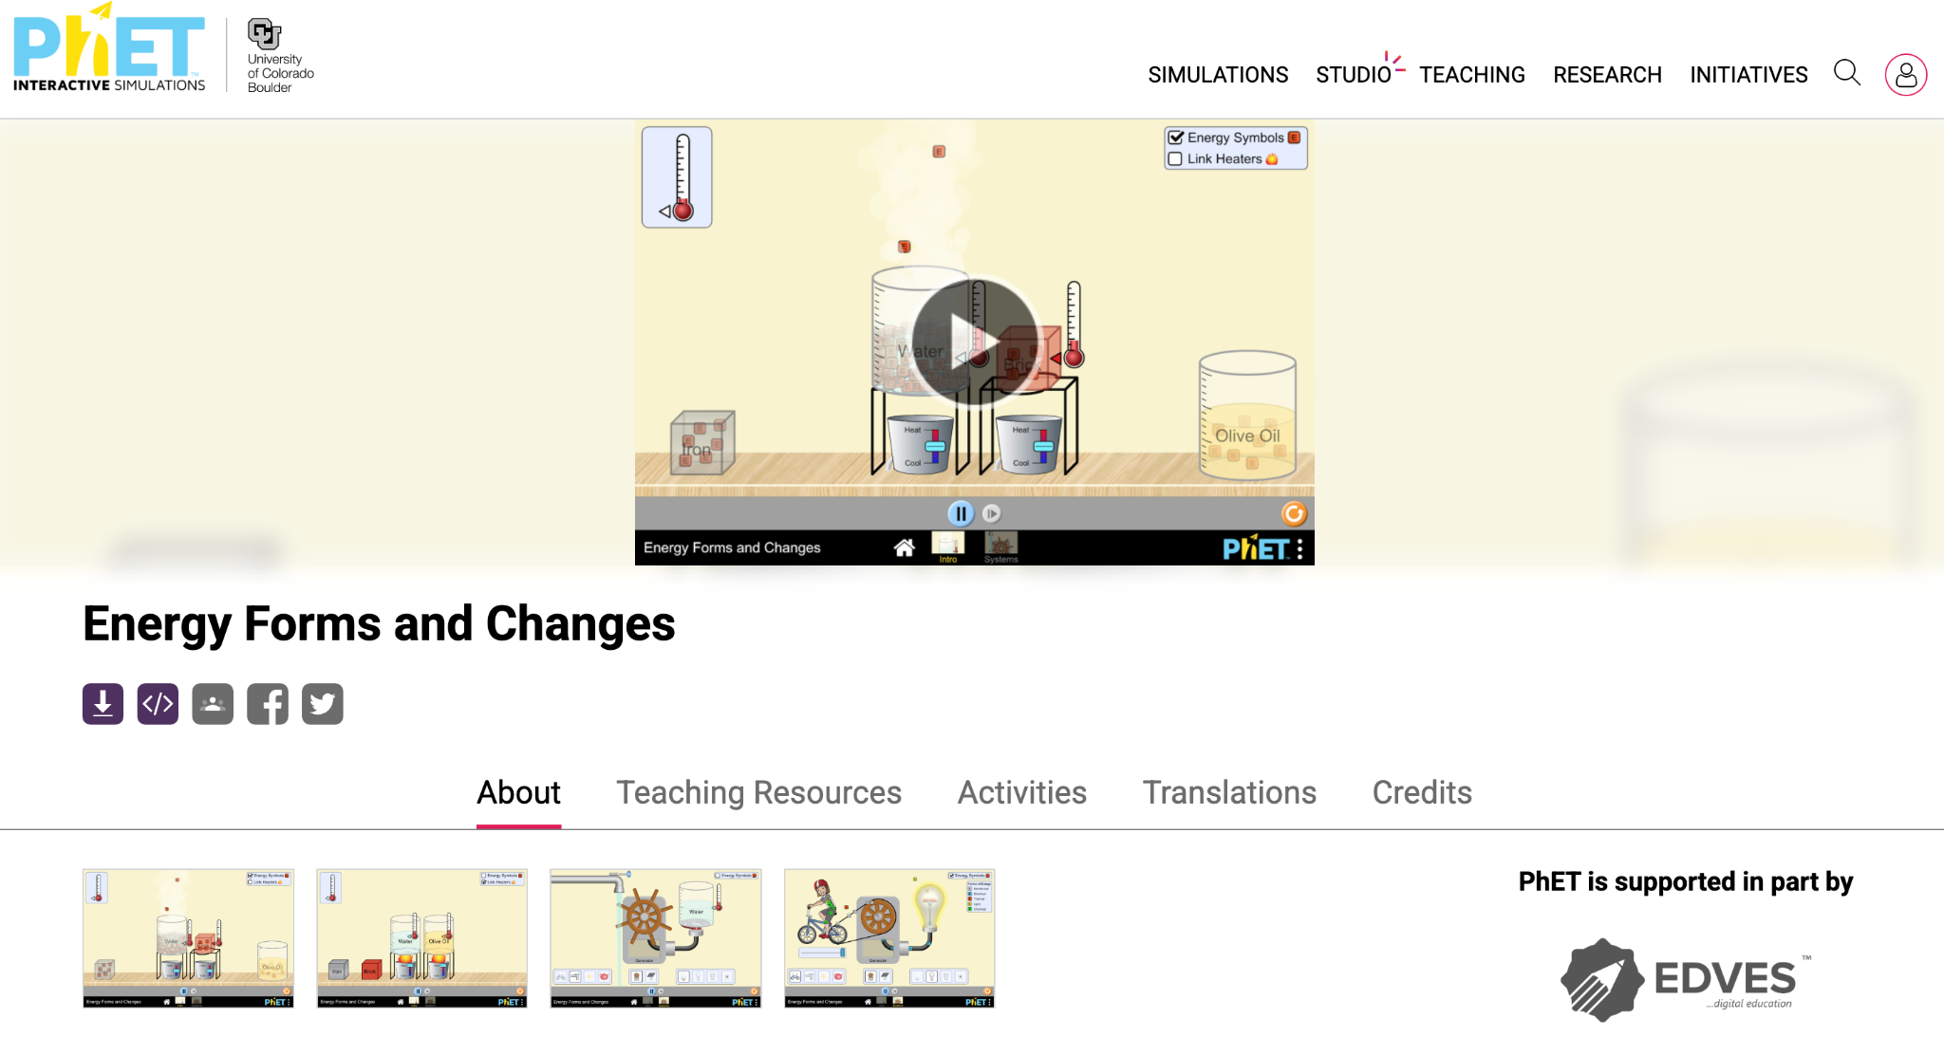
Activity: Energy forms and changes
Use the PhET Simulation - Energy Forms and Changes to complete the interactive activity.

Slide 15
SOURCE OF ENERGY?

Slide 16
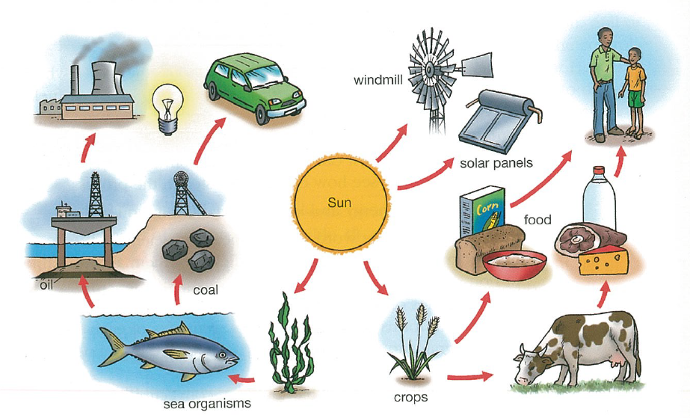
SOURCES OF ENERGY
“…the sun is the original source of most energy on Earth.”
Explain how this is true using driving a car (which uses petrol) as an example.
Cars run on oil (petrol)
Oil is made from millions of dead plants and animals (from thousands of years ago).
Plants get their energy from the sun.
Animals get their energy from plants (or other animals).

Slide 17
1ST LAW OF THERMODYNAMICS & ENERGY TRANSFORMATIONS

Slide 18
THE 1ST LAW OF THERMODYNAMICS
= The Law of Conservation of Energy
“The total amount of energy in the universe is constant. Energy cannot be created or destroyed, it can only change place or form.”

Slide 19
THE 1ST LAW OF THERMODYNAMICS
This could be written like this:
Student in class:
Chemical energy (food) → kinetic energy + heat energy + sound energy
We call these ENERGY TRANSFORMATIONS.
For the following slides,
What is the energy going in, what is the energy changing/transforming into?

Slide 20

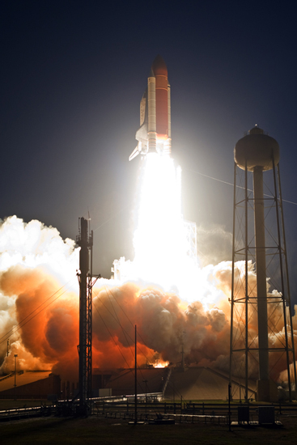
Energy transfer
When work is done, energy is transferred. That energy might be:
gravitational potential energy – e.g. when an object changes height within a gravitational field
kinetic energy – e.g. when an object changes speed
light energy – e.g. when a light bulb is switched on
heat and sound – e.g. when a car brakes sharply.
Notes:
Photo credit: NASA
From Launch Pad 39A at NASA's Kennedy Space Center in Florida, space shuttle Discovery races toward space atop towers of flame. Clouds of smoke and steam engulf the pad below. Launch on mission STS-119 was on time at 7:43 p.m.
Teacher notes
Students could be asked to list energy changes in difference devices, such as power stations, engines and household appliances.
See the ‘Materials’ presentation for more information about elastic potential energy.
‹#›
Boardworks AS Physics
Title of presentation

Slide 21
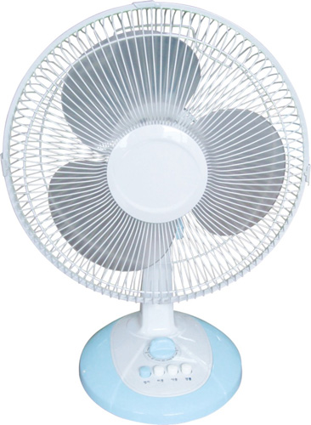
Electrical energy
→ kinetic energy
(+ heat energy
+ sound energy)

Slide 22
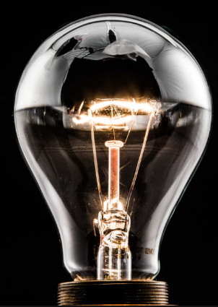
Electrical energy → light energy (+ heat energy)

Slide 23

(kinetic energy) → Elastic potential energy → kinetic energy
(+ heat energy + sound energy)

Slide 24
NOW YOUR TURN!
For the following energy changes,
Think of a new object or situation which has this energy change.
e.g.
Q: CHEMICAL ENERGY → HEAT ENERGY
A: You!

Slide 25
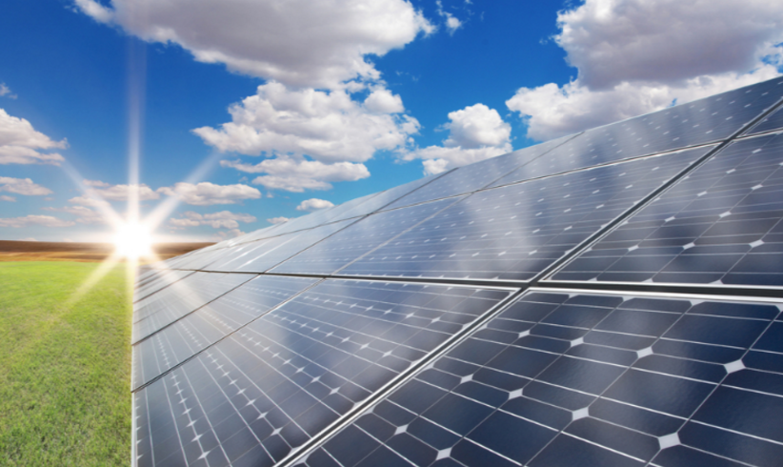
Light energy → electrical energy

Slide 26

Chemical energy → Kinetic energy → gravitational potential energy

Slide 27

Light energy → chemical energy

Slide 28
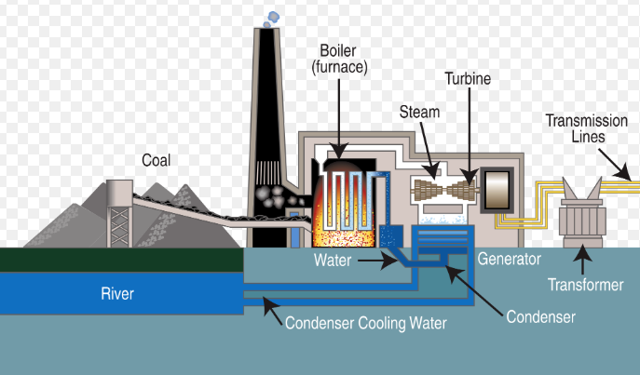
Chemical energy → heat energy → kinetic energy → electrical energy

Slide 29

Chemical energy → electrical energy → sound + light energy

Slide 30
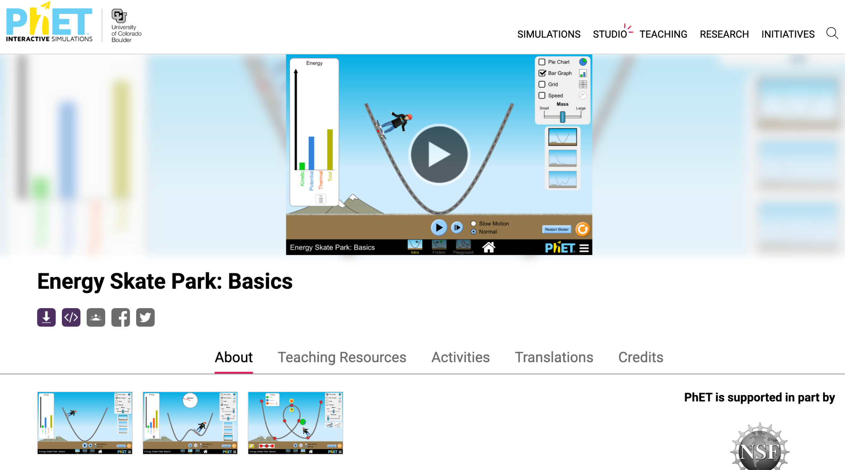
Activity: Skate Park Basics
Use the PhET Simulation - Skate Park Basics to complete the interactive activity.

